Slide 1
VLSI IMPLEMENTATION IN HARDWARE SECURITY MODULE BASED ON AES ENCRYPTION METHOD
Primary goal no | : | 9
Secondary goal no | : | 11
Tertiary goal no | : | 16

Slide 2

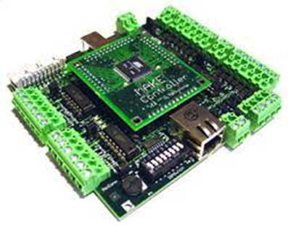

To enhance system security, we would employ our adaption of AES encryption to fortify the hardware security module's security in a Network Centric Warfare Ecosystem.
A HSM(Hardware Security Module) chip is embedded in a Microcontroller of a System.

Slide 3
Cryptography is very important now-a-days for data security and integrity as the ecommerce and internet applications has increased. But, it has least importance in many cases because of extra memory and other requirements needed for the implementation. The main aim of this work is to implement Advanced Encryption Standard (AES) Encryption using Verilog. To protect data like electronics, cryptographic algorithms are used. Each round of encryption associated with delay can be reduced by AES parallel design. This work proposes a low power and high throughput implementation of AES algorithm using key expansion approach. We minimize the power consumption and critical path delay using the proposed high-performance architecture. The fundamental goal of the initiative is to increase data flow, although security considerations have become increasingly important over time. The use of encryption and decryption techniques inside VLSI has recently increased since cryptography can convert plaintext to cipher and vice versa. The most recent developments in cryptography technology will be applied in the hardware security module. by simultaneously writing a lot of HDL modules. The main objective is to send and receive data securely without allowing data to be hacked, as well as to improve the performance of a specific parameter. The methodology involved in this system is Verilog code. To support both analog and digital circuit designing, Xilinx provides analog and digital platform. It is interesting to note that any encryption algorithm works in a digital environment and all the blocks in the system will handle digital data in security.

Slide 4
S.no | Journal details And Year | Authors and title of the paper | Inference
1 | Journal of Electrical Systems and Information Technology 2 (2015) 178–183 | Power efficient and high performance VLSI architecture for AES algorithm K. Kalaiselvi a,∗, H. Mangalam | Advanced encryption standard(AES) algorithm has been widely deployed in cryptographic applications. This work proposes a low power and high throughput implementation of AES algorithm using key expansion approach.

Slide 5
S.no | Journal details And Year | Authors and title of the paper | Inference
2 | IEEE 2013 | VLSI IMPLEMENTATION OF AES ALGORITHM SAURABH KUMAR | This paper presents In the past cryptography means only encryption and decryption using secret keys, nowadays it is defined in different mechanisms like asymmetric-key encipherment (public key cryptography) and symmetric-key encipherment (called as privet-key cryptography).

Slide 6
S.no | Journal details And Year | Authors and title of the paper | Inference
3 | IEEE 2017 | VLSI Implementation of Cryptographic Algorithms & Techniques: A Literature Review Favin Fernandes, Gauravi Dungarwal, Aishwariya Gaikwad, Ishan Kareliya, Swati Shilaskar | Through the years, the flow of Data and its transmission have increased tremendously and so has the security issues to it. Cryptography in recent years with the advancement of VLSI has led to its implementation of Encryption and Decryption techniques, where the process of translating and converting plaintext into cypher text and vice versa is made possible

Slide 7
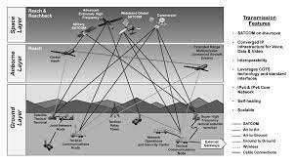
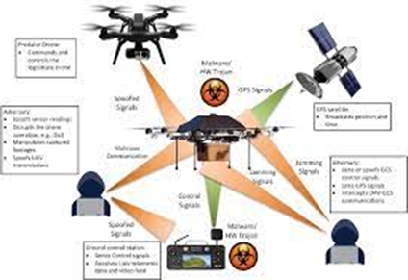
Security is becoming a crucial component of contemporary warfare.
Cyberattacks account for the majority of attacks. Cyberattack against Systems, Aircraft, Drones, and other Military Equipment, etc.
These seriously harm a nation's collateral. In order to achieve our goal of improving system security, we would use our adaptation of AES encryption to strengthen the security of the hardware security module, which is an HSM (Hardware Security Module) chip implanted in the system controller.

Slide 8
We would examine the most recent version of AES encryption first, modify it to reach the algorithm's optimum efficiency, and then implement it in a Hardware Security Module.
After that We would implement into a Controller for further study of the Security of the Controller System.

Slide 9
ZNQC FPGA Board
Viv ado Ise

Slide 10
Select an AES 256 algorithm
Analysis It and improve the efficiency of the algorithm
Write the program for this algorithm in Verilog (Xilinx after that Viv ado software)
Test the code in the normal FPGA Kit
Implement this chip on a controller
From this we can modify for the defence sectors
Test the code in the Zynq FPGA Kit
Check for the desired output

Slide 11
Currently we are the Research and Analysis of the algorithm so that we don't have any working model

Slide 13
AES encryption is the finest encryption among RSA, DES, and AES, as we have learned by studying encryption techniques. This uses the most recent version of AES (256).
This leads us to the conclusion that this project might have research on the definition of cryptography, the AES encryption algorithm, and Xilinx software. From this study, we would modify the AES Encryption algorithm in the best way possible and implement it in the FPGA kit.

Slide 14
We intended to enhance this project by using an FPGA kit to implement the optimal algorithm in the circuit.
Embed this in a controller so that we could check the controller's security and create a commercial product.

